Slide 1
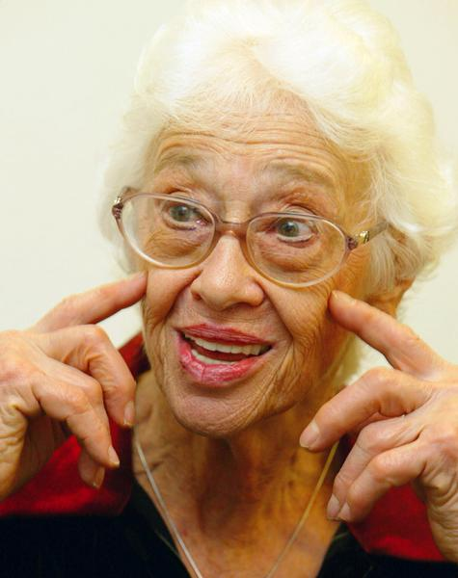
The Validation Method
Naomi Feil

Slide 2
Honesty & integrity
Respect
Emotive Empathy
Basic Attitude
Theory
Techniques
Principles
Goals of Validation
Understanding aging and dementia
Prerequisites
Verbal techniques
Non-verbal techniques

Slide 3
Validation Principle 1. Maloriented and disoriented old people are unique and worthwhile.

Slide 4
Validation Principle 2. Maloriented and disoriented old people should be accepted as they are: we should not try to change them.

Slide 5
Validation Principle 3. Listening with empathy builds trust, reduces anxiety and restores dignity.

Slide 6
Empathy
Sympathy: I know how you feel
Confrontation: Why did you do that?
Diversion: Let’s not think about it. How about a cup of coffee?
Reassurance: It’s okay. Don’t worry.

Slide 7
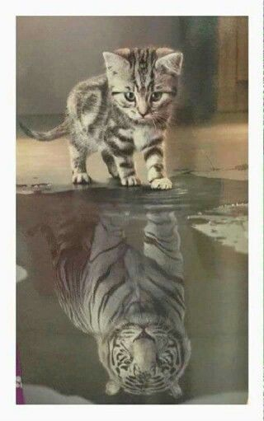
Validation Principle 4. Painful feelings that are expressed, acknowledged and validated by a trusted listener will diminish.
Painful feelings that are ignored or suppressed will gain in strength.

Slide 8
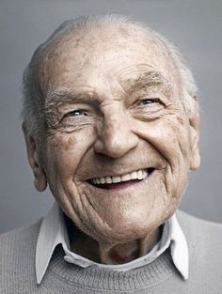
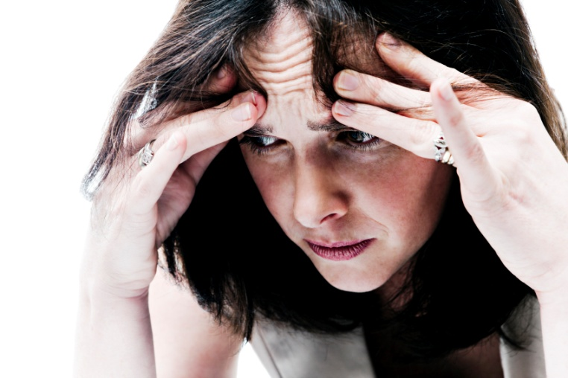
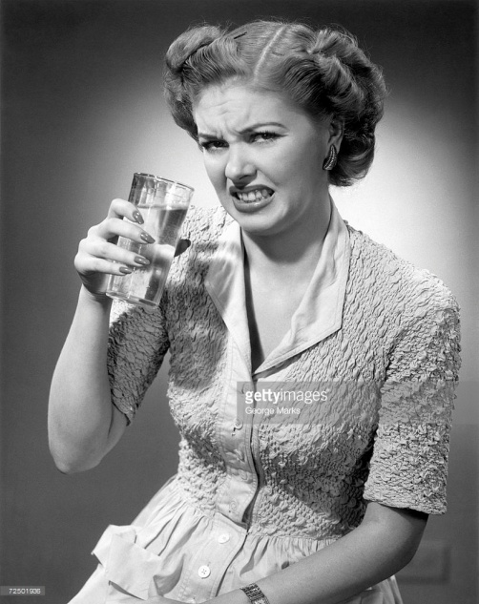
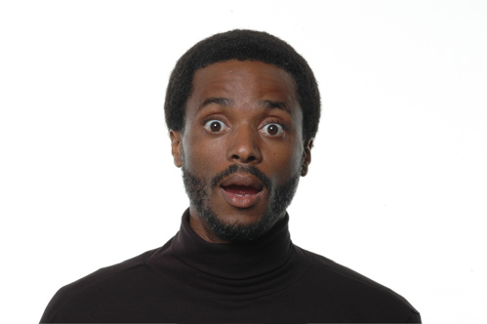
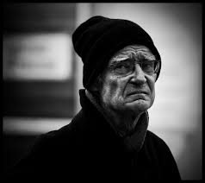
Basic Human Emotions

Slide 9
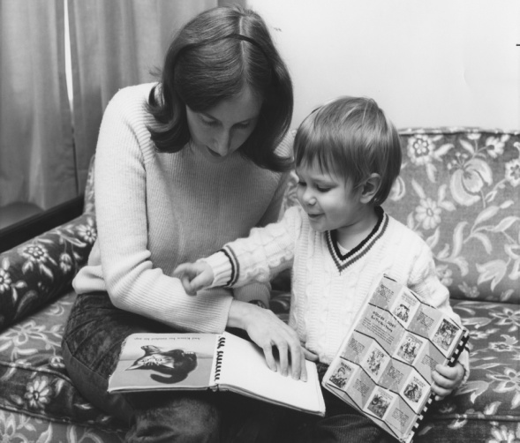
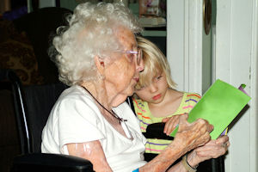
Validation Principle 5. There is a reason behind the behavior of very old maloriented and disoriented people

Slide 10
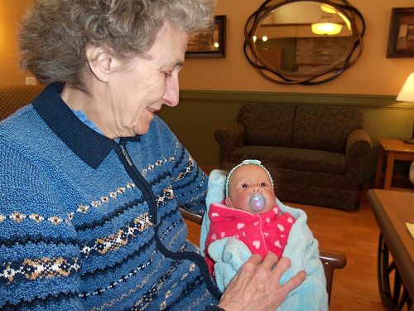
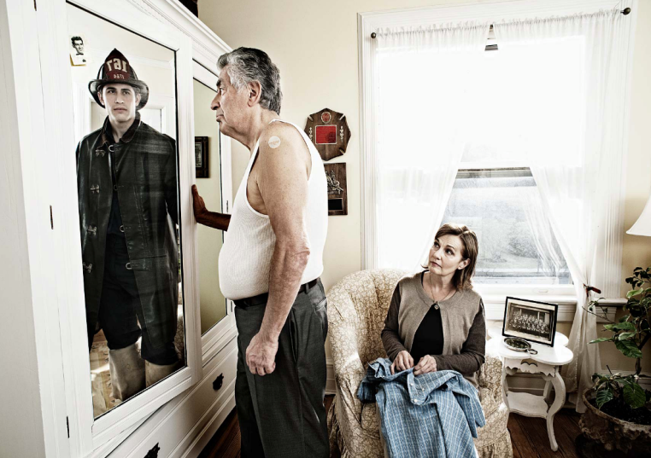
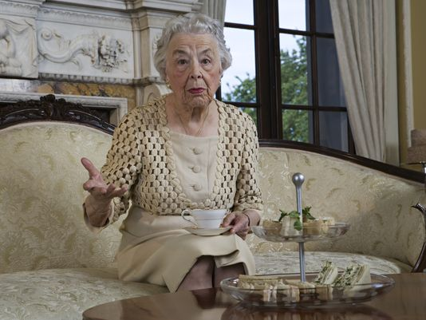
Validation Principle 6. The reasons can be one or more of the following basic human needs:
Give/get love
Be useful
Recognition

Slide 11
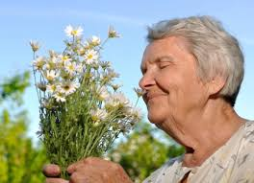
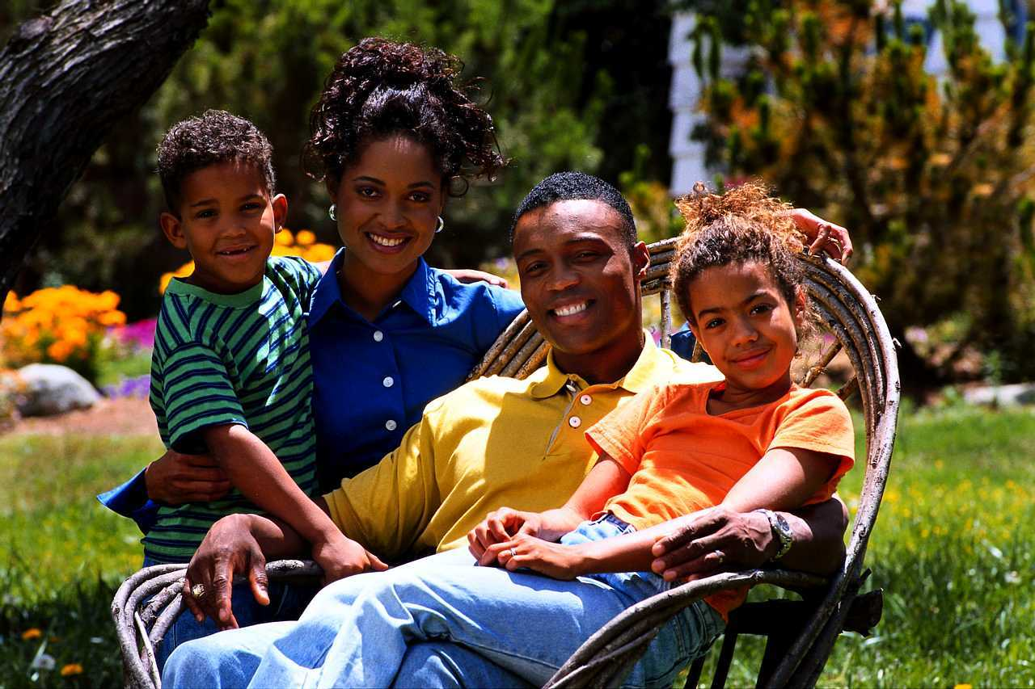
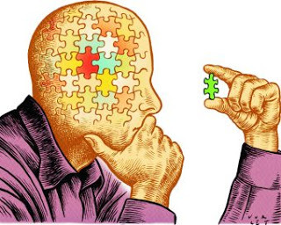
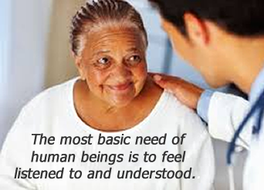
Basic Human Needs
Sensory Stimulation
Feel Safe and Secure
Make sense of reality

Slide 12
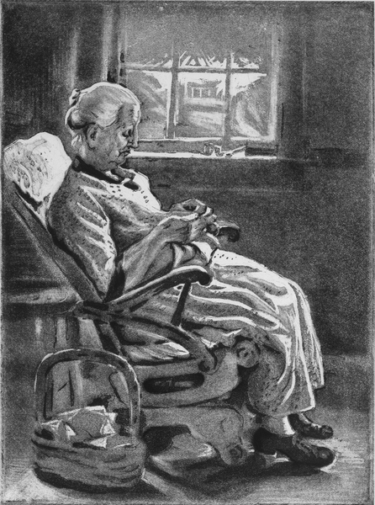
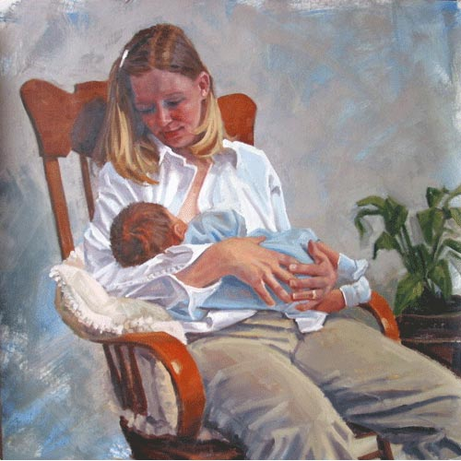
Validation Principle 7. Early learned behaviors return when verbal ability and recent memory fails:

Slide 13
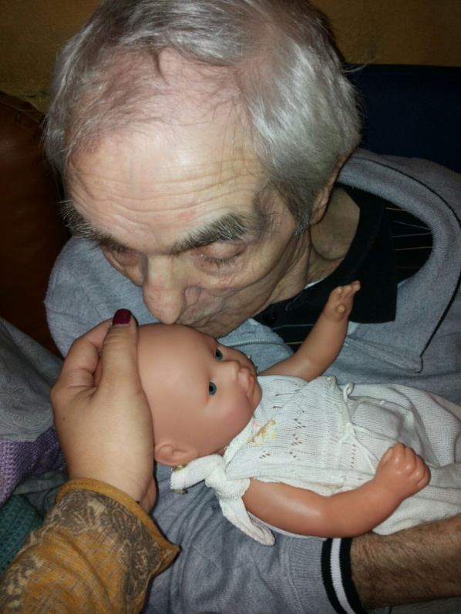
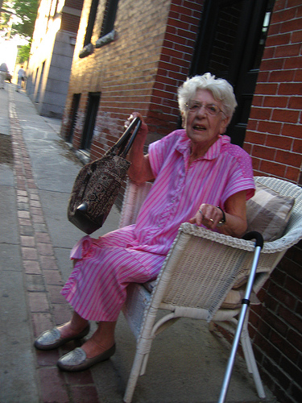
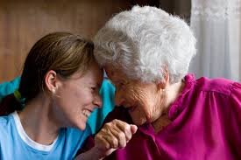
Validation Principle 8. Personal symbols represent people, things or concepts from the past that are laden with emotion.

Slide 14
Validation Principle 9. Maloriented and disoriented old people live on several levels of awareness, often at the same time.
Conscious
Unconscious
Pre-conscious

Slide 15
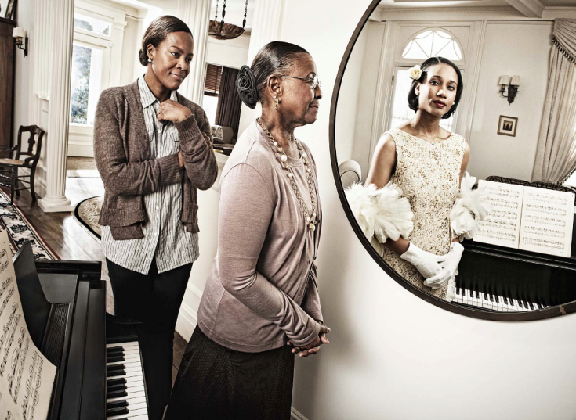
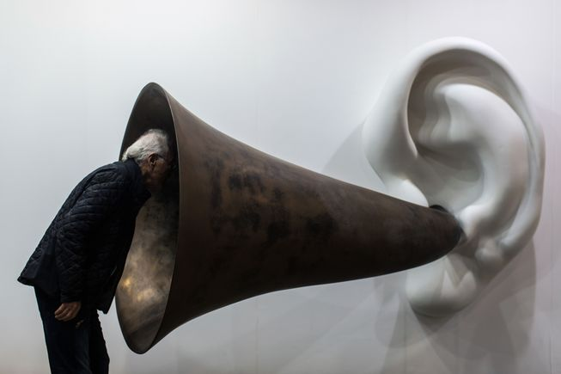
Validation Principle 10. When the 5 senses fail, maloriented and disoriented elderly stimulate and use their ‘inner senses’.

Slide 16
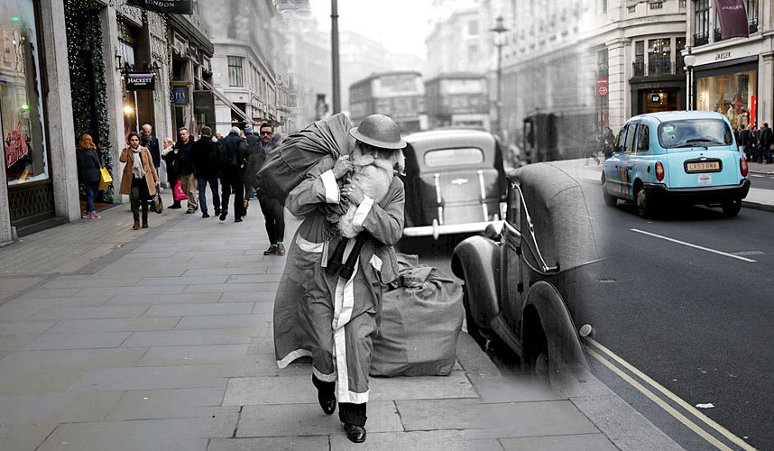
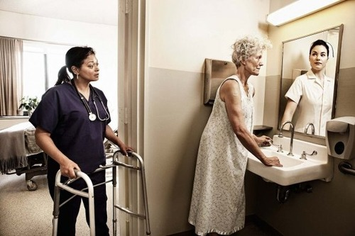
Validation Principle 11. Events, emotions, colors, sounds, smells, tastes and images create emotions, which in turn trigger similar emotions experienced in the past.

Slide 17
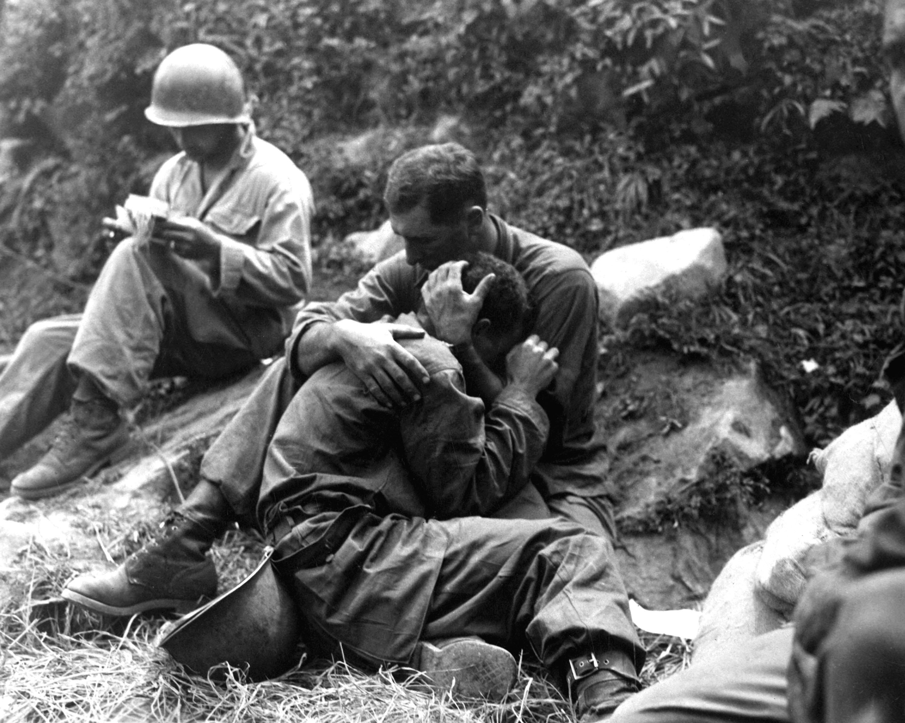
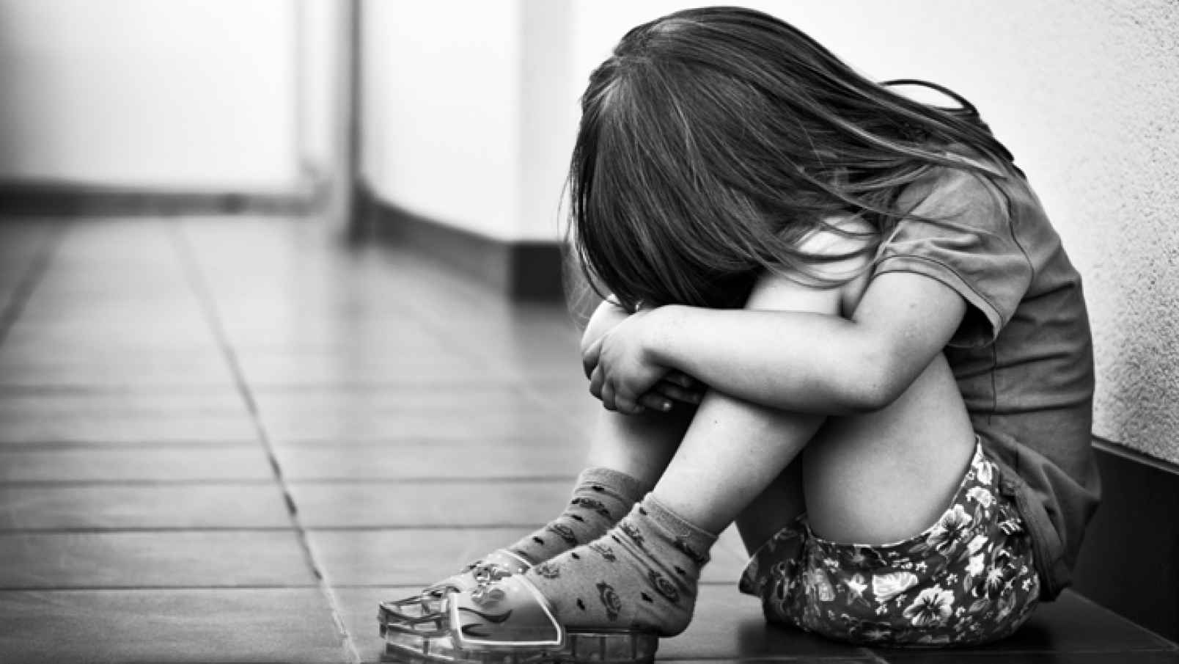
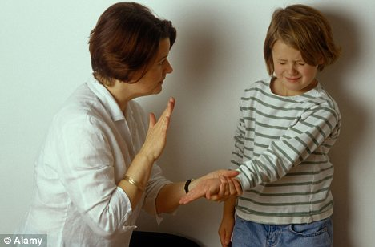
Possible unresolved Life Events

Slide 18
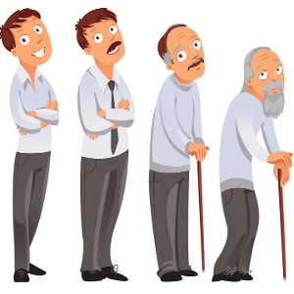
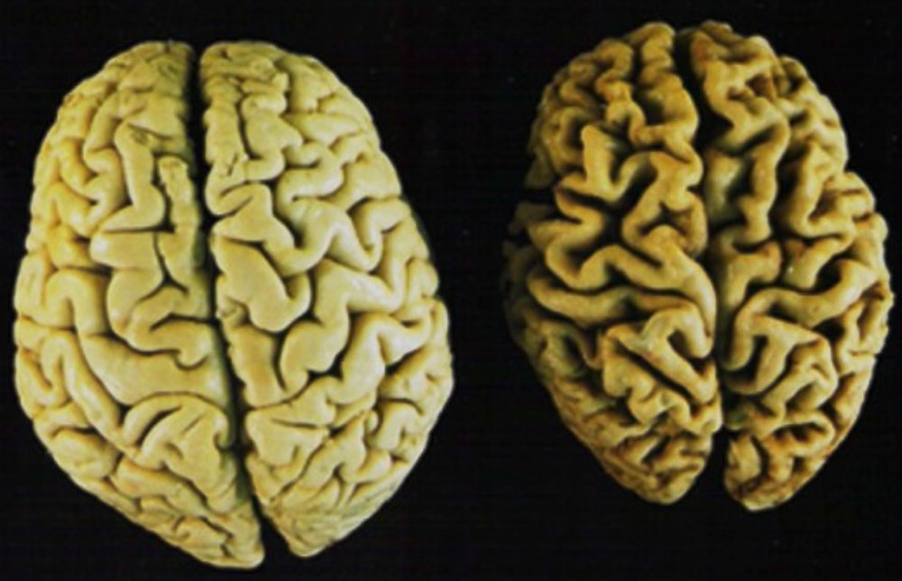
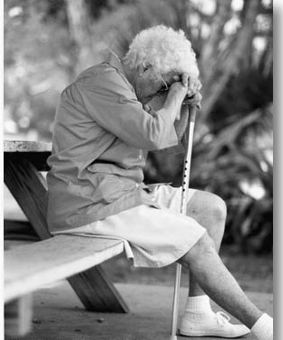
Normal Aging

Slide 19
Understanding people who respond best to Validation
Gerotrancendence
+
Losses
No coping skills to handle losses
Normal Aging
Old-old Age
Integrity
Generativity
Intimacy
Identity
Industry
Initiative
Autonomy
Trust
Old Age
Adult
Young Adult
Adolescence
School Age
Play Age
Early Childhood
Infancy
Despair
Stagnation
Isolation
Identity Confusion
Inferiority
Guilt
Shame
Mistrust

Slide 20
Understanding people who respond best to Validation Losses that come with aging
Physical:
Short-term memory
Eyesight
Hearing
Circulation
Illnesses increase
Often ability to walk is reduced
Social/psychological:
Death of loved ones, friends
Isolation
Loss of job or role in life
Lack of status respect
No one listens
Lack of sensory stimulation

Slide 21
Understanding people who respond best to Validation
Despair
Stagnation
Isolation
Identity- Confusion
Inferiority
Guilt
Shame
Mistrust
Feil’s Resolution Stage of Life
Task: to die in peace
Losses
No coping skills to
handle losses
+
4 Phases of Resolution
Malorientation
withdrawal
Time Confusion
withdrawal
Repetitive Motion
withdrawal
Vegetation
Disorientation

Slide 22
Understanding people who respond best to Validation
Feil’s Resolution Stage of Life
Task: to die in peace
There is a reason behind the behavior:
4 Phases of Resolution
Malorientation
withdrawal
Time Confusion
withdrawal
Repetitive Motion
withdrawal
Vegetation
Retreat...
Relieve...
Resolve...
Relive...
Express unfulfilled needs...

Slide 23
Understanding people who respond best to Validation
Retreat...
Relieve...
Resolve...
Relive...
Express unfulfilled needs...
Basic Human Needs:
To reduce pain and discomfort
To have sensory stimulation
To be nurtured, feel safe and secure
To belong, to be loved
To express emotions and be heard
To be listened to and respected
To be useful
To be recognized, status, identity and self-worth
To restore a sense of equilibrium
To live in peace
To die in peace

Slide 24
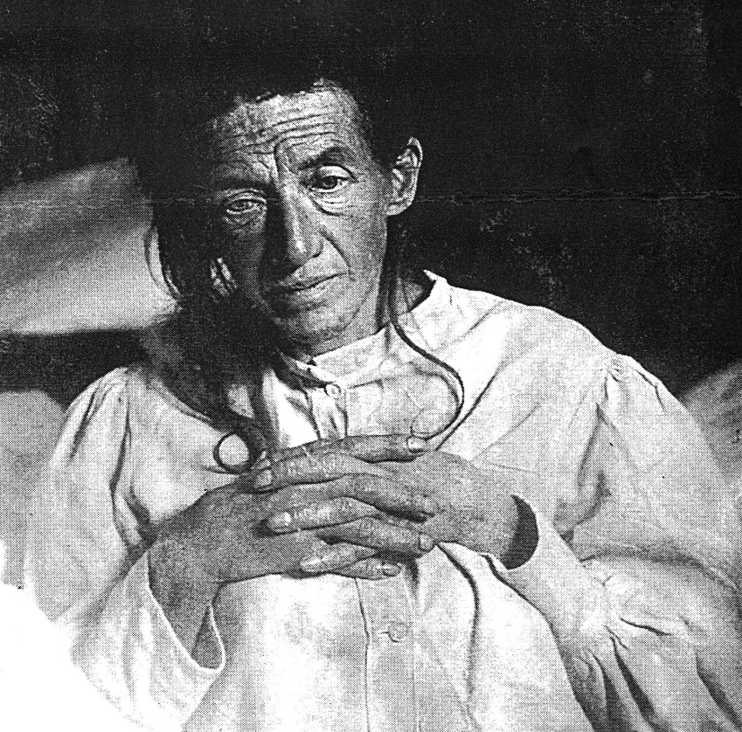
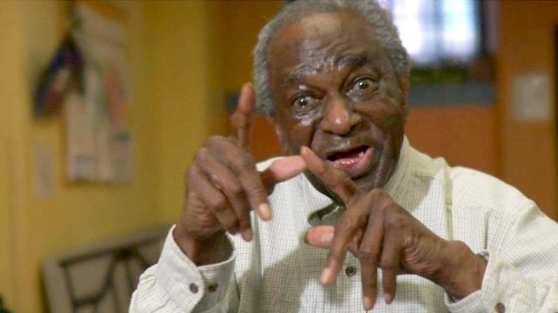
The difference between a person with Alzheimer’s disease and a disoriented very old person

Slide 25
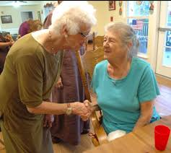
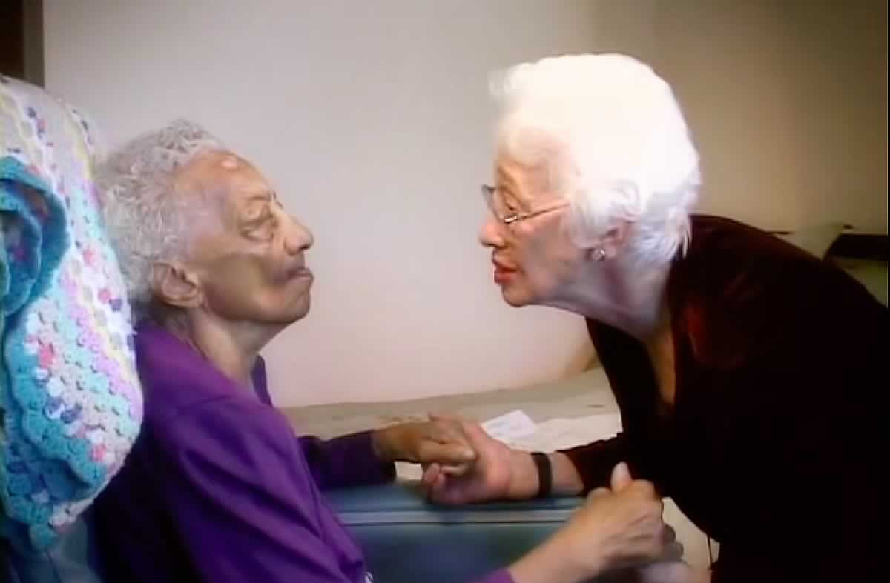
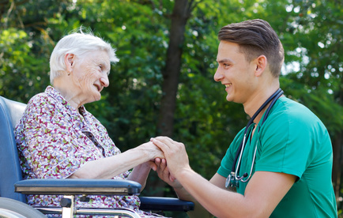
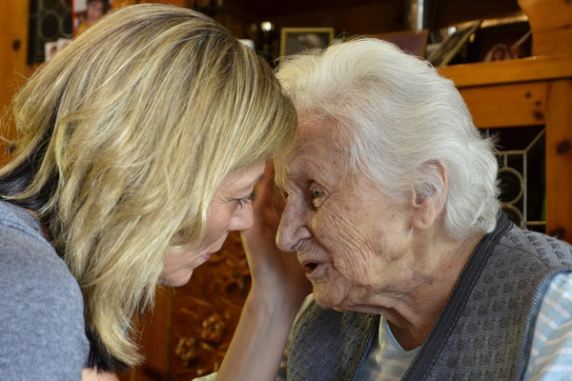
The Validation Process

Slide 26
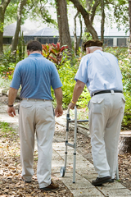
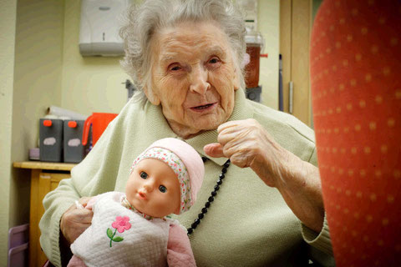
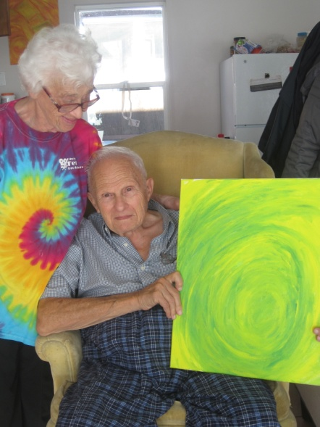
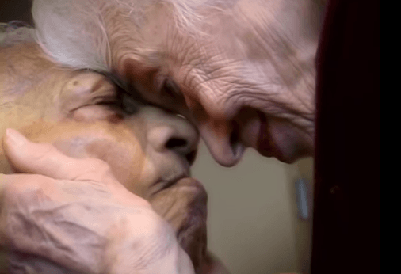
Validation goals – in the short term

Slide 27
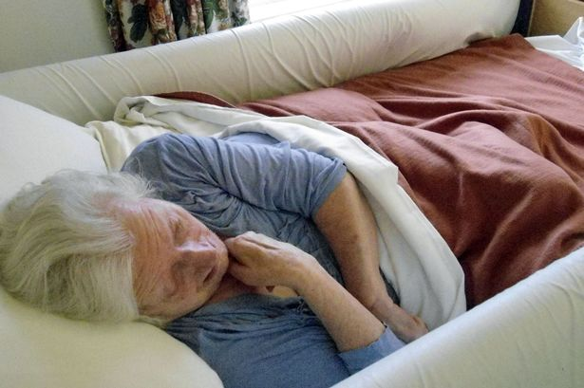
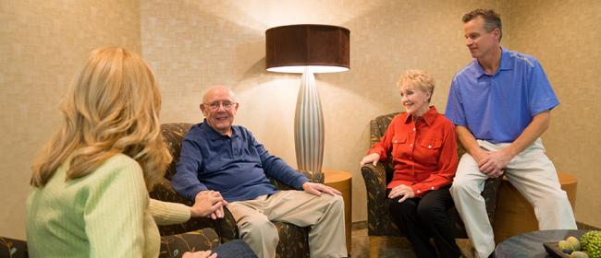
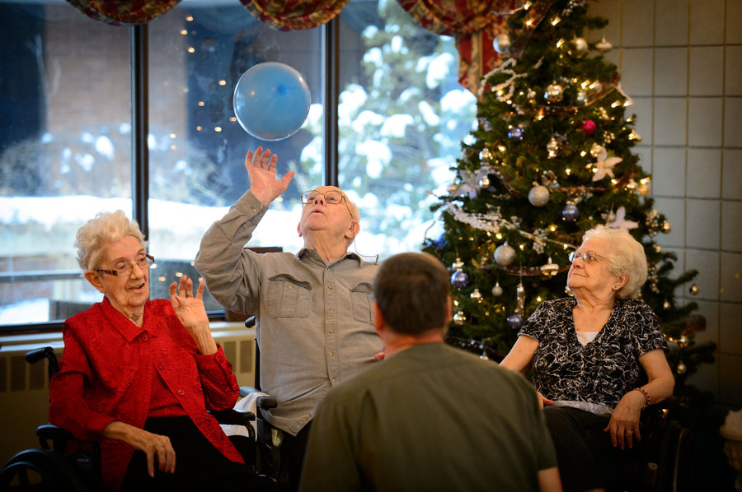
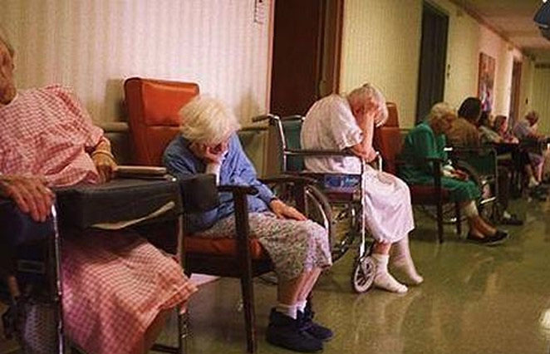
Validation goals – in the long term

Slide 28
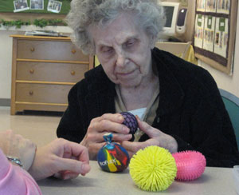
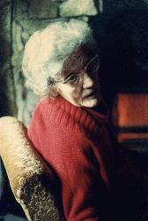
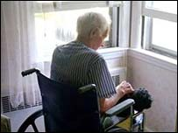
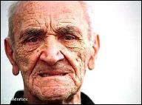
“Goals” of the Client
Re-live
Relieve
Retreat
Resolve
Express Needs

Slide 29
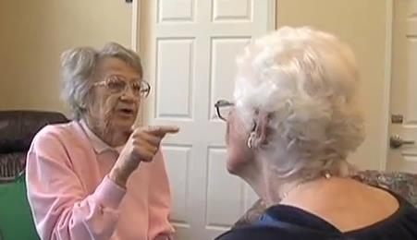
Four Phases of Resolution

Slide 30
Malorientation

Slide 31
Techniques for Phase One verbal Validation techniques
Center
Observe

Slide 32
Techniques for Phase One verbal Validation techniques
Find the right distance

Slide 33
Verbal Validation techniques
Eye contact

Slide 34
Verbal Validation techniques
Rephrasing
ABCDE
ABEDC?

Slide 35
Verbal Validation techniques
Imagine the opposite
Ask the Extreme-Polarity
I have to go home now!
I have to go home now!
What would happen if you stayed here?
What’s the worst thing about being here?

Slide 36
Verbal Validation techniques
Reminiscing
Find an old coping mechanism
I miss my home.
I miss my home.
Have you ever missed something before? What did you do? What helped?
What was home like?

Slide 37
Verbal Validation techniques
Preferred Sense
Listen for sensory word choices
Breathing
Tone of voice
Eye Cues

Slide 38
Guidelines for videos

Slide 39
Time Confusion

Slide 40
Techniques for Phase Two Non-verbal Validation Techniques
Use Anchored Touch

Slide 41
Non-verbal Validation techniques
clear, low, warm, loving voice tone
Genuine, direct eye contact

Slide 42
Non-verbal Validation Techniques
Observe the emotion, match their emotion
Express their emotion - with emotion

Slide 43
Non-verbal Validation Techniques
Use ambiguity
Use music and movement
He/she/it
They/those

Slide 44
Non-verbal Validation techniques
Link the behavior to the need

Slide 45
Preferred sense – eye cues
visual
auditory
kinesthetic

Slide 46
Songs

Slide 47
Repetitive Motion

Slide 48
Techniques for Phase Three
Mirroring with empathy

Slide 49
Non-verbal Validation Techniques
Use Anchored Touch

Slide 50
Non-verbal Validation techniques
Say the emotion – with emotion
Are you sad? I see a tear.

Slide 51
Non-verbal Validation techniques
Ambiguity
Does “it” hurt
You love “her”
What did “they” do?
Do you miss “him”

Slide 52
Non-verbal Validation techniques
Link the behavior to the need
To give/get love?
To be useful?
To be recognized?
To be safe?
To be a mother?
To be working?
To go home?

Slide 53
Music

Slide 54
Vegetation

Slide 55
Techniques for people in Vegetation

