Slide 1
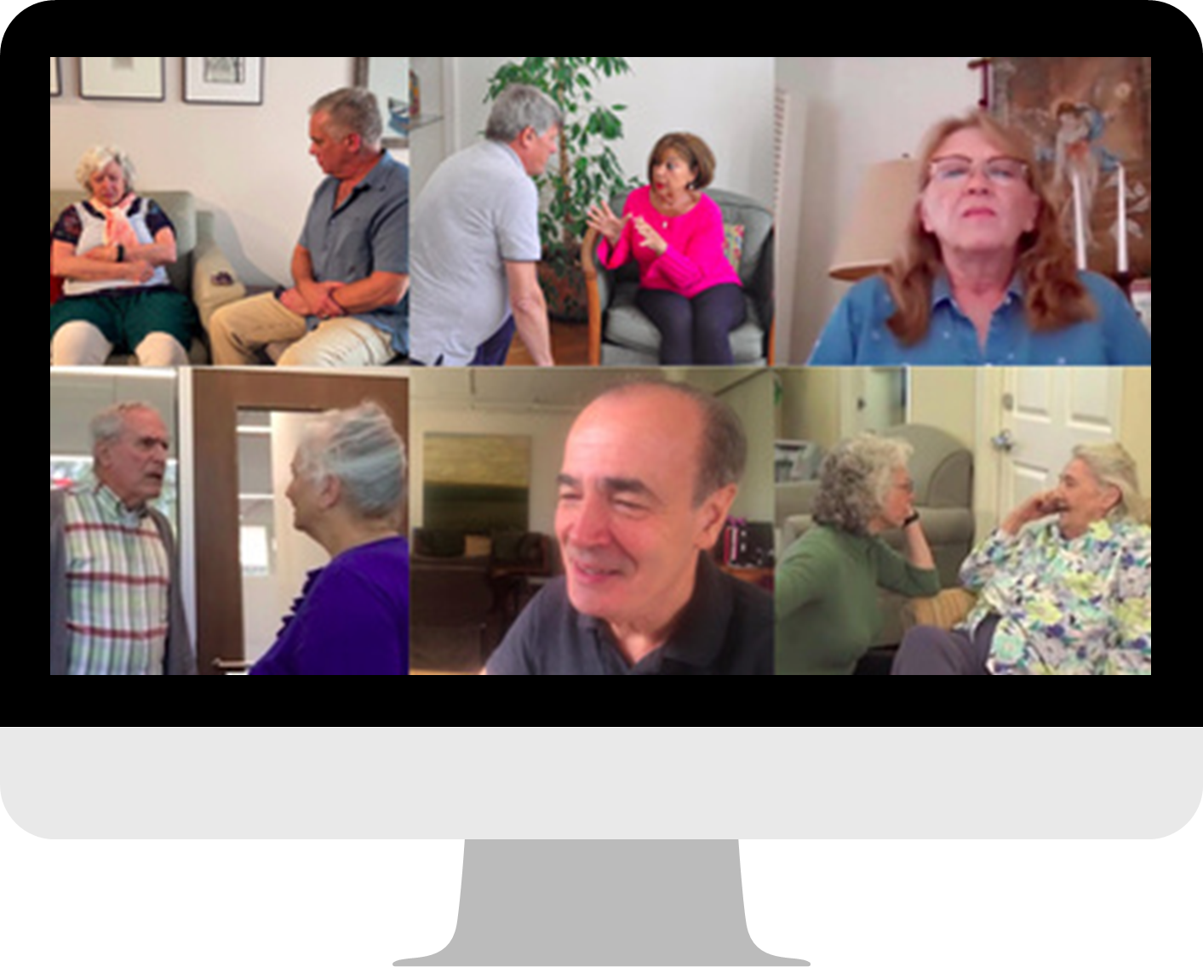
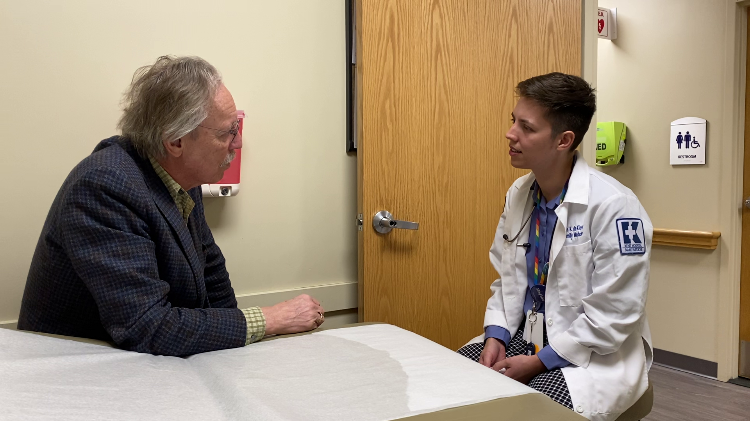
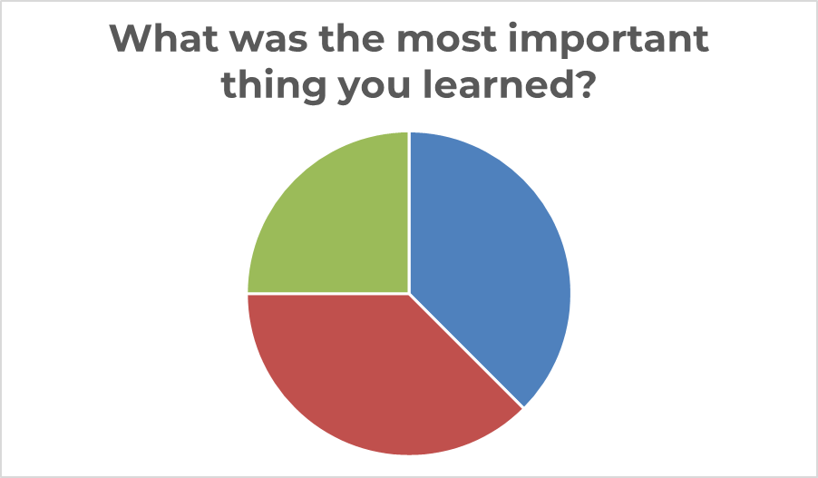
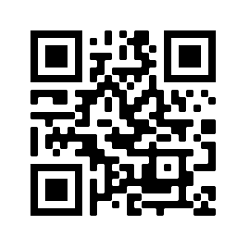
Communication Training for Medical Professionals:
Proof of Concept Nancy L Brown, M.A., Jerusalem, Israel; University of Edinburgh, UK Vicki de Klerk-Rubin, R.N., MBA, The Netherlands Validation Training Institute
POS 1 – 59
The Validation for Medical Professionals Training effectively brought new insights and skills to medical professionals.
“Validation has made me a better doctor. It has changed my perspective on aging” (participant).
Intervention Design
5 Lessons: all online
Approximately 1 hour every week
Asynchronous videos, quizzes and case studies
Coaching: Live 30–60-minute zoom webinars led by a Certified Validation Teacher after each lesson
Introduction:
Physicians, medical students, and other medical professionals receive little or no dementia-specific training to help them communicate effectively with older adults living with cognitive change.
Methods:
Pre- and post-surveys: (1) Knowledge scale; (2) Self-Efficacy to Respond to Disruptive Behaviors (SRDB) ranked on a Likert scale of 1 to 5 and analyzed using SPSS.
Post-training individual interviews concluded the beta-testing.
Result:
Despite the small sample size, the validated measurements showed trends approaching significance in knowledge and self-efficacy. Participants highly valued the training's content and pedagogy.
Conclusions:
Overall, the Validation method was found useful in practice. It improved confidence, knowledge, and communication skills.
25% Everything
38% Attitude
related
38% Techniques
related
Significant results: Paired Samples Test Self-Efficacy to Respond to Disruptive Behaviors | Significance One-sided p
T1.401 T1: I am confident in my ability to respond effectively to disruptive behaviors among older adults experiencing memory loss. | .018
T1.404 T1: I know how to respond to disruptive behaviors effectively. | .010
T1.406 T1: In stressful situations, I would be able to respond effectively to disruptive behaviors. | .010
T1.407 T1: In normal situations, I would be able to respond effectively to disruptive behaviors. | .010
Validation Training Institute
nancy@vfvalidation.org

