Slide 1
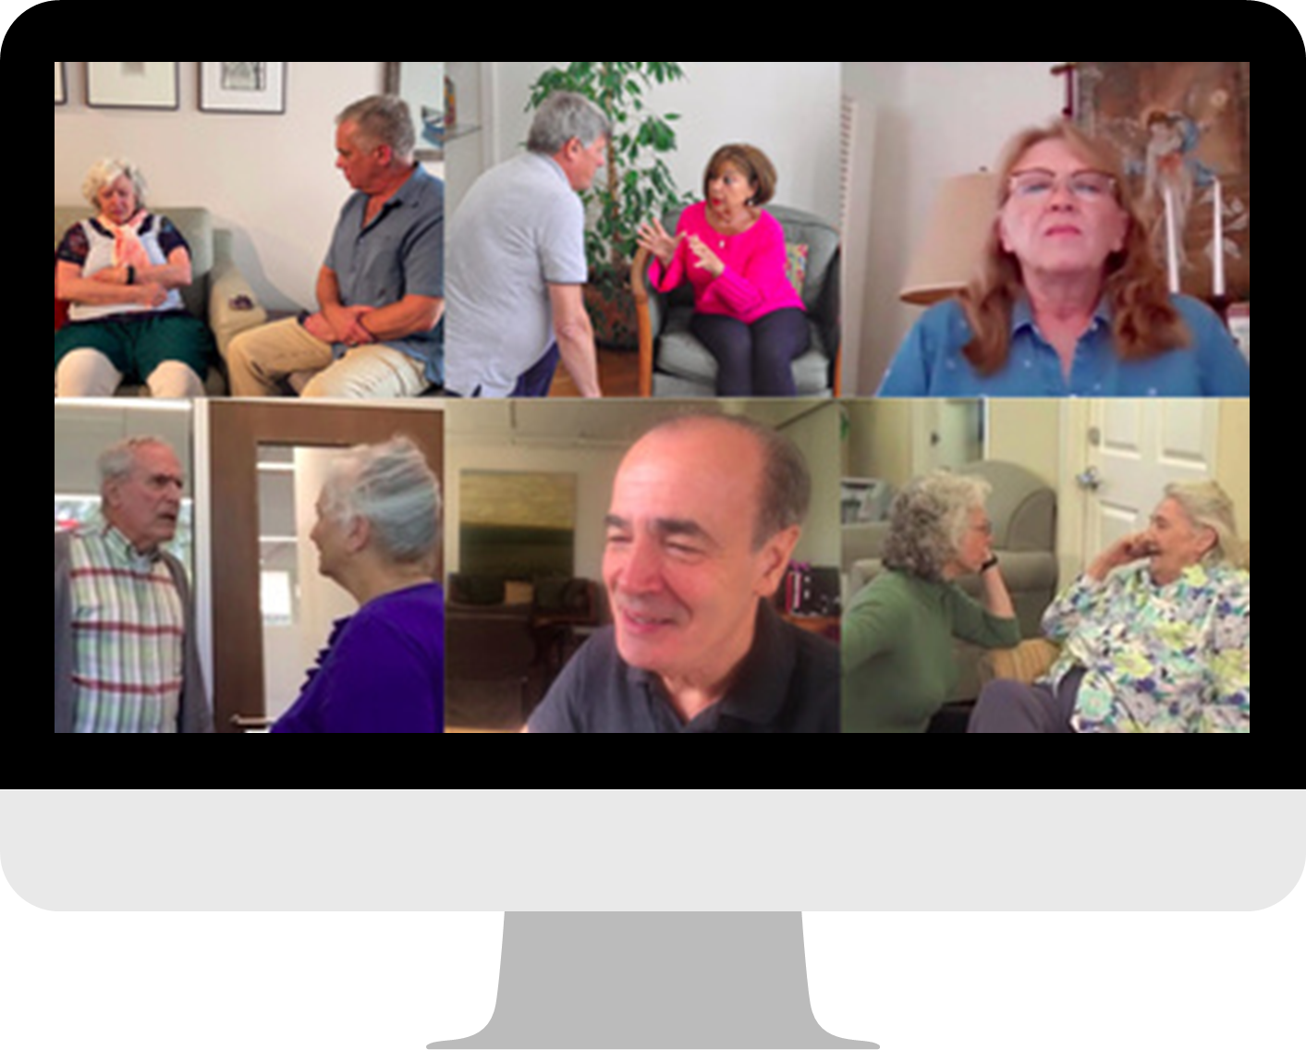
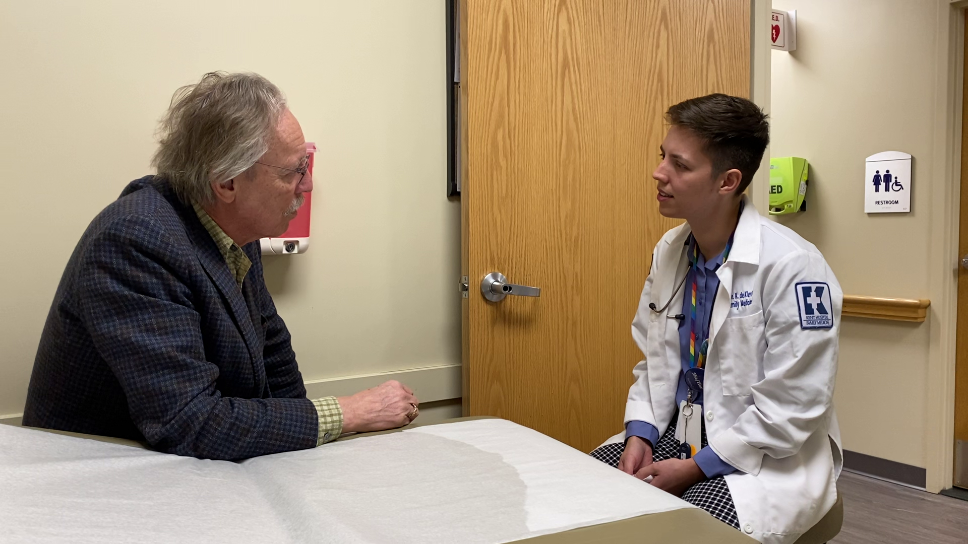
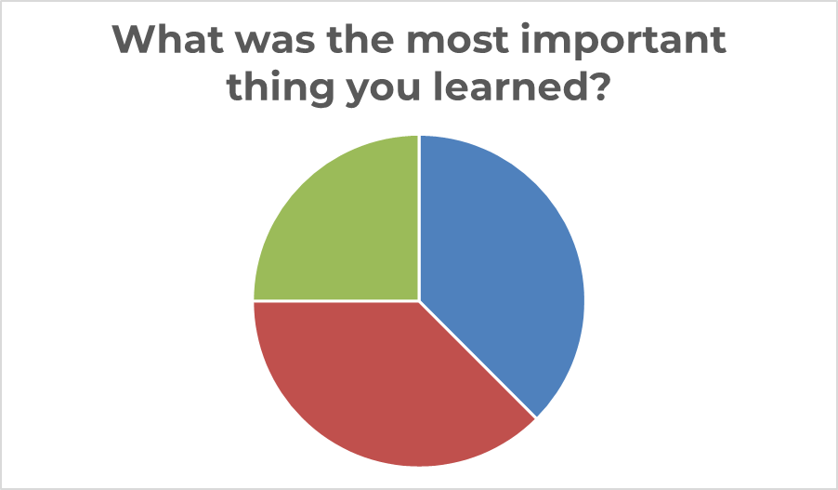
Communication Training for Medical Professionals: Proof of Concept
GSA 2024
1795400
Nancy L Brown, M.A., Jerusalem, Israel; University of Edinburgh, Edinburgh, U.K.
Vicki de Klerk-Rubin, R.N., MBA, The Netherlands; Validation Training Institute
Introduction:
Physicians, medical students, and other medical professionals receive little or no dementia-specific training to help them communicate effectively with older adults living with cognitive change.
Methods:
Pre- and post-surveys: (1) Knowledge scale; (2) Self-Efficacy to Respond to Disruptive Behaviors (SRDB) ranked on a Likert scale of 1 to 5 and analyzed using SPSS.
Post-training individual interviews concluded the beta-testing.
Result:
Despite the small sample size, the validated measurements showed trends approaching significance in knowledge and self-efficacy. Participants highly valued the training's content and pedagogy.
Conclusions:
Overall, the Validation method was found useful in practice. It improved confidence, knowledge, and communication skills.
34AEC
The Validation for Medical Professionals Training effectively brought new insights and skills to medical professionals.
“Validation has made me a better doctor. It has changed my perspective on aging” (participant).
INTRODUCTION
25% Everything
38% Attitude
related
25% Everything
38% Attitude
related
38% Techniques
related
38% Techniques
related
METHODS
RESULTS
CONLUSIONS
Significant results: Paired Samples Test Self-Efficacy to Respond to Disruptive Behaviors | Significance One-sided p
T1.401 T1: I am confident in my ability to respond effectively to disruptive behaviors among older adults experiencing memory loss. | .018
T1.404 T1: I know how to respond to disruptive behaviors effectively. | .010
T1.406 T1: In stressful situations, I would be able to respond effectively to disruptive behaviors. | .010
T1.407 T1: In normal situations, I would be able to respond effectively to disruptive behaviors. | .010
The pilot program included physicians and other healthcare professionals. In this single-group design, pre- and
post-surveys consisted of a knowledge scale and SRDB (self-efficacy) ranked on a Likert scale of 1 to 5 and
analyzed using SPSS. Post-training individual interviews concluded the beta-testing. Thirty professionals enrolled in
the training; eight participants completed every aspect of the beta-testing.
Intervention Design
5 Lessons: all online
Approximately 1 hour every week
Asynchronous videos, quizzes and case studies
Coaching: Live 30–60-minute zoom webinars led by a Certified Validation Teacher after each lesson
CONTACT US
Skills taught:
Centering
Observing & Calibration
Respectful eye contact
Finding an appropriate distance
Using an ‘adult-to-adult’ voice tone
Ask, don’t tell
Validation Training Institute
nancy@vfvalidation.org

